Slide 1
Health care
Or Livne
Roei

Slide 2
Backgrounds
aaa

Slide 3
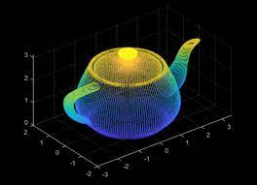
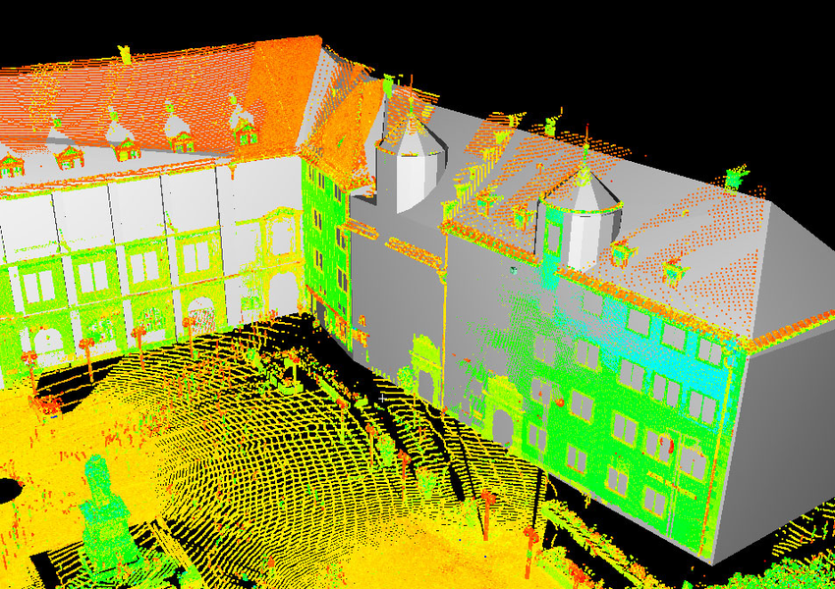
point CLOUD
What is points cloud is ?
How to create point cloud ?
How are they using in different applications ?

Slide 4
point CLOUD
What is points cloud is ?
Collection of individual 3D point which can be presented by:
Location: (X, Y, Z)
Additional information (Like color (R,G,B) values)
https://www.youtube.com/watch?v=IKfbiFQB_0U

Slide 5
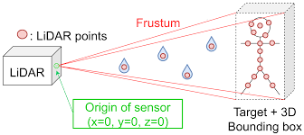
point CLOUD
How to create point cloud ?
Scan by using laser scanner
The laser sending a pulse into static object, by measuring the reflect reaction from the object by laser scanner we can represent each point exact location in 3D

Slide 6
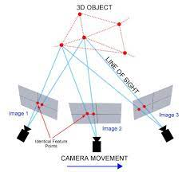
point CLOUD
How to create point cloud ?
Process name Photogrammetry
Creating point cloud by using multiple image of the same object, by triangulate process, the algorithm knows to generate the point cloud

Slide 7
point CLOUD
Mashes:
Convert point cloud to Mesh is a technique for reconstructing a surface mesh from an input point cloud.
In order to move from point cloud in 3D, we move to mesh representation:
https://ranahanocka.github.io/point2mesh/

Slide 8
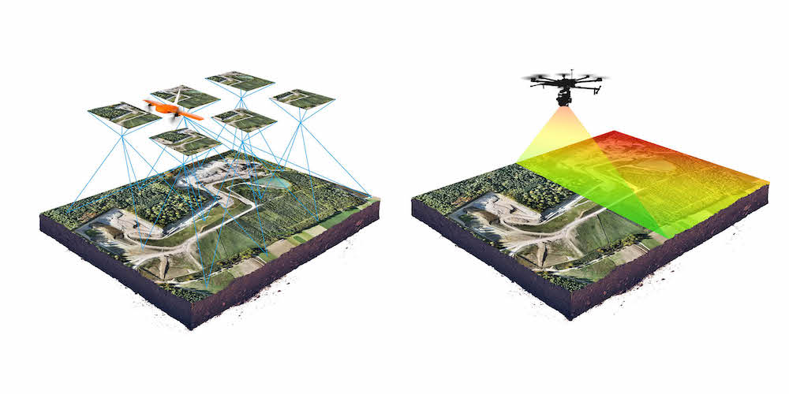
Photogrammetry vs. laser scanner
photogrammetry advantages:
High ability to reproduce an object in full color and texture, While not any 3D scanners can do this
easily accessible to most people because the equipment and software is nowhere near as expensive as 3D scanning.
photogrammetry disadvantages:
challenging to work with parts that have a smooth, flat …
real time as 3D scanning
lower accuracy than 3D scanners.

Slide 9
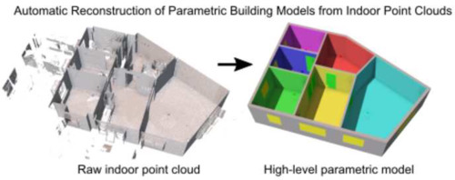
point CLOUD
How are they using in different applications ?
Create a 3D model - point cloud converted into meshes
Understanding environment – building, automotive
Manufacturing – design product

Slide 10
TIMELINE
aaa

Slide 11
transformers
aaa

Slide 12
VISUAL transformers
aaa

Slide 13
DISADVANGES
aaa

Slide 14
ADVANGES
aaa

Slide 15
Paper flow
Transformer for Point Cloud Representation
Point-based deep learning
Vision transformers
NLP transformers

Slide 16
Paper flow
Vision transformers:

Slide 17
Paper flow
Vision transformers:

Slide 18
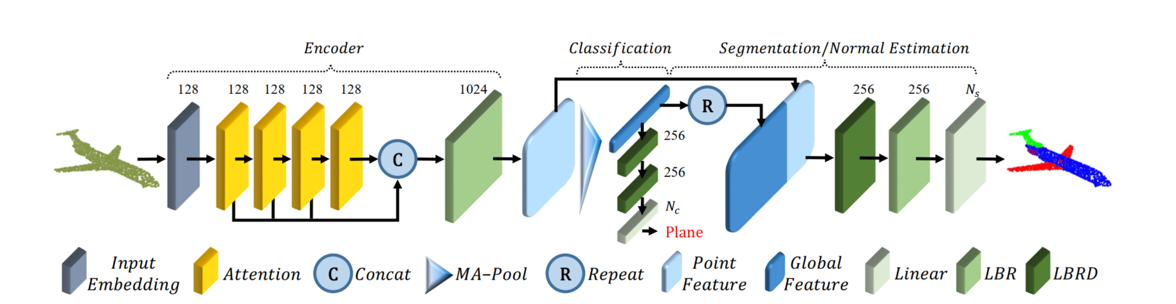
ARCHITHCHER
aaa

Slide 19
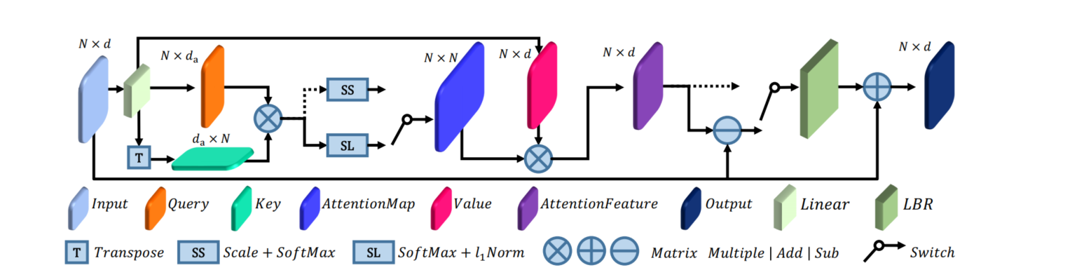
ARCHITHCHER
aaa

Slide 20
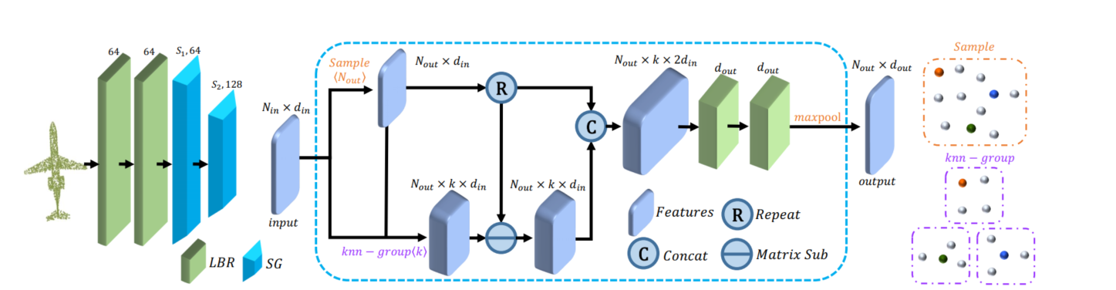
ARCHITHCHER
aaa

Slide 21
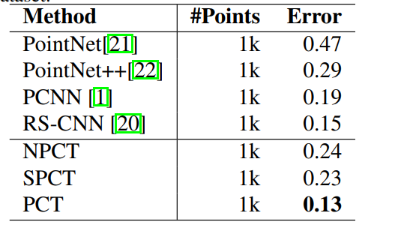
ARCHITHCHER
aaa

Slide 22
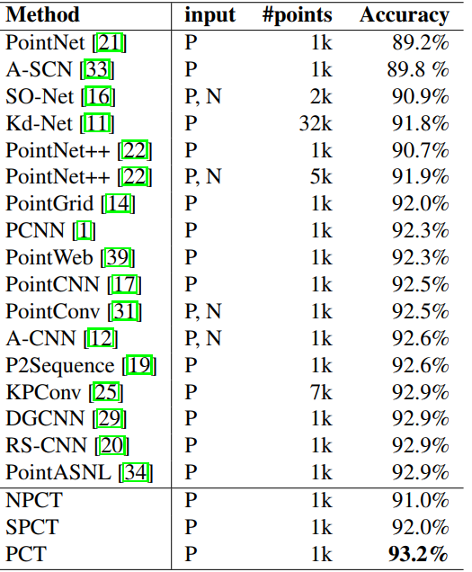
ARCHITHCHER
aaa

Slide 23

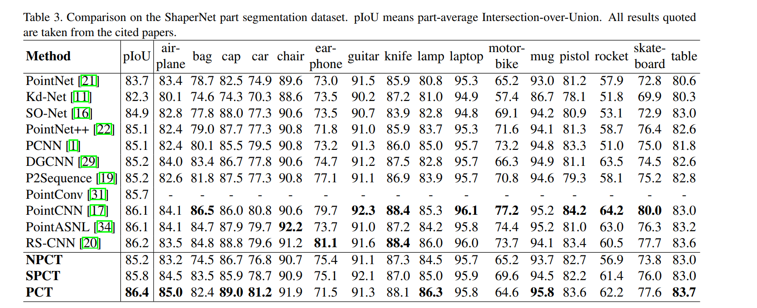
ARCHITHCHER
aaa

Slide 24
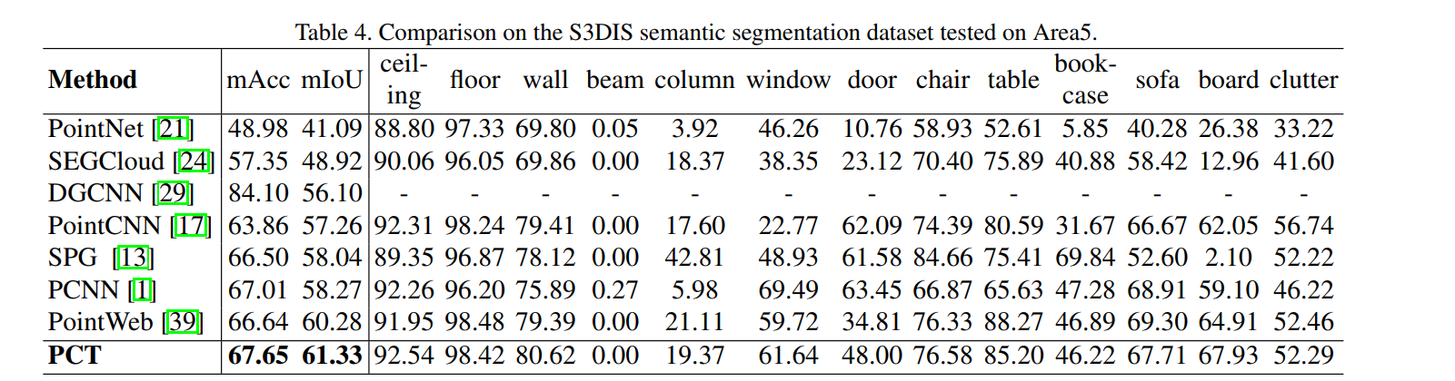
ARCHITHCHER
aaa

Slide 25
Point cloud in health care
aaa

Slide 26
CONCULISION
In this paper, we propose a permutation-invariant point cloud transformer, which is suitable for learning on unstructured point clouds with irregular domain. The proposed offset-attention and normalization mechanisms help to make our PCT effective. Experiments show that PCT has good semantic feature learning capability, and achieves state-of-the-art performance on several tasks, particularly shape classification, part segmentation and normal estimation. Transformer has already revealed powerful capabilities given large amounts of training data. At present, the available point cloud datasets are very limited compared to image. In future, we will train it on larger datasets and study its advantages and disadvantages with respect to other popular frameworks. Besides, the encoder-decoder structure of Transformer support more complex tasks, such as point cloud generation and completion. We will extend the PCT to further applications

